Slide 1


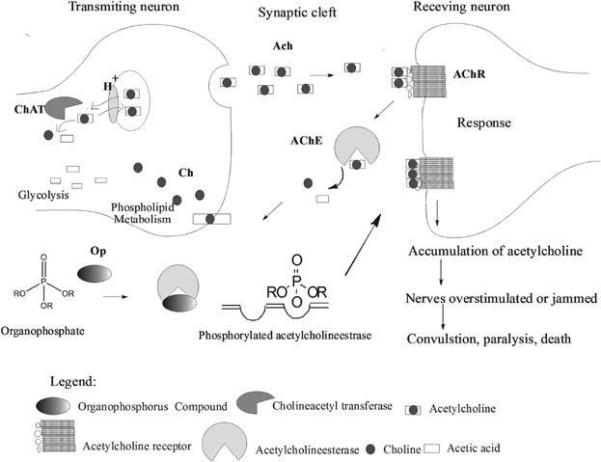
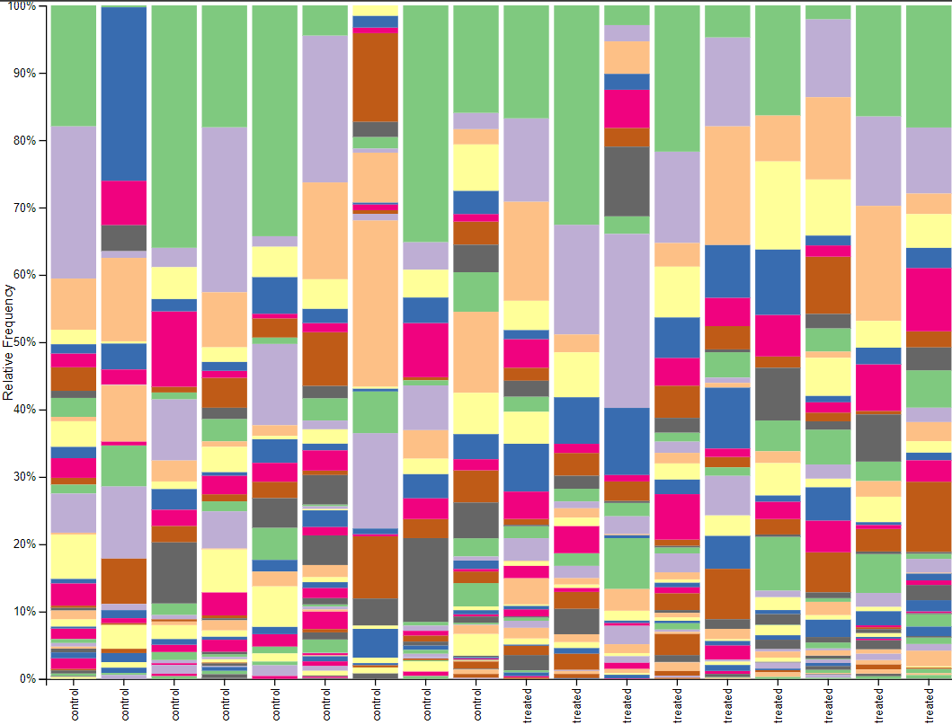
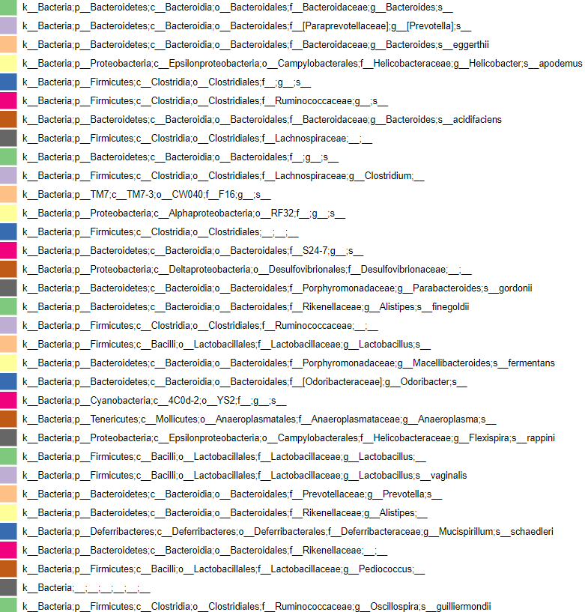
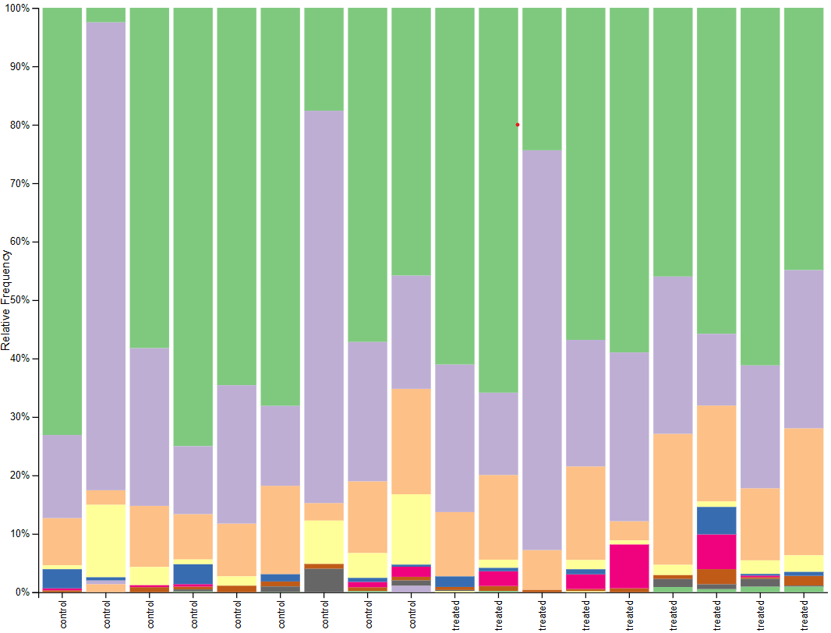
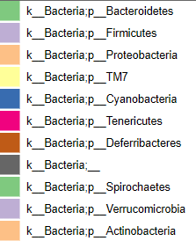
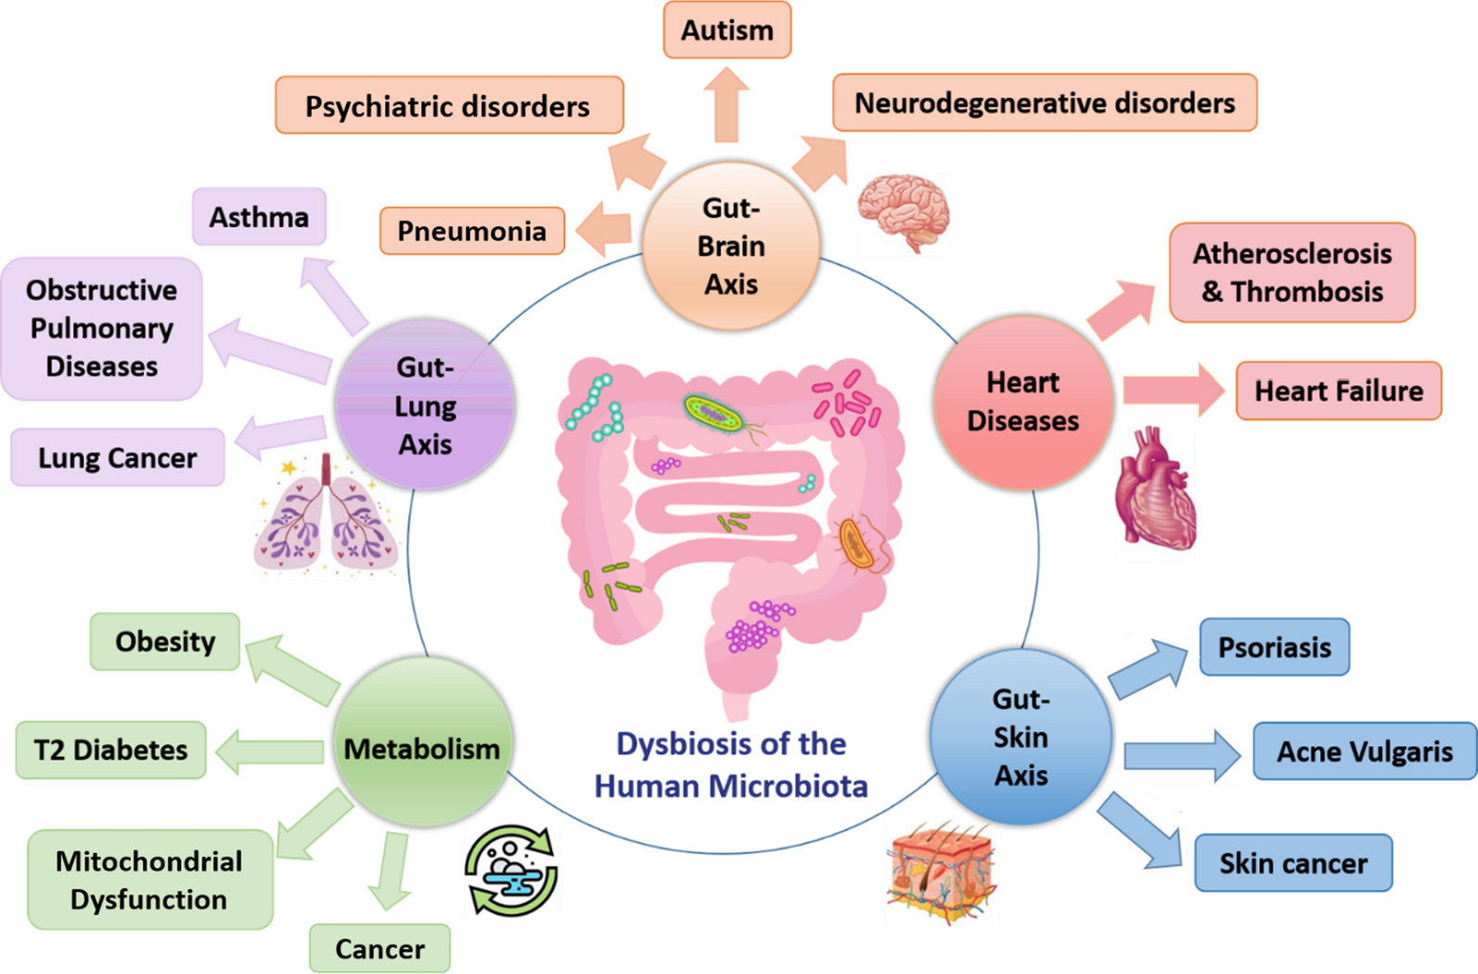
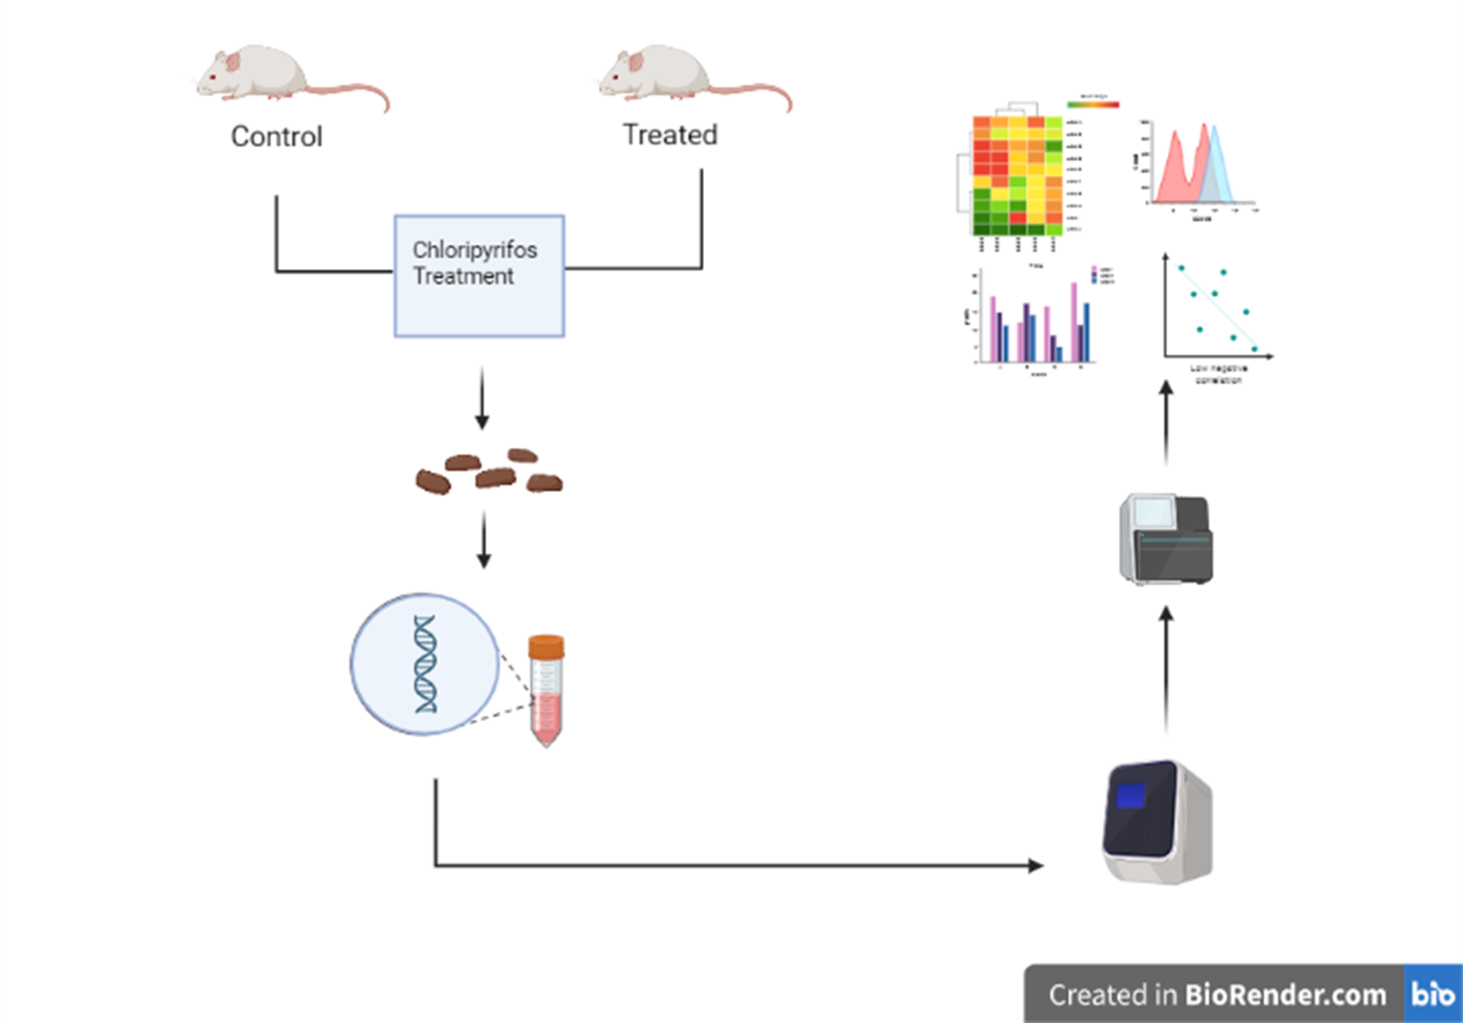
Taxonomic Annotation of 16s rRNA gene sequences in Chlorpyrifos an organophosphate pesticide treated mice.
Kavinraj S, Mahalakshmi P and Ramasamy S*
Action of chlorpyrifos
QIIME2 PIPELINE
Taxonomy results
Key Image 1
Data import
Demultiplexing
Metadata
Phylogenetic diversity
Alpha diversity
Gut microbiota
Key Image 3
Beta diversity
Alpha rarefaction
Taxonamic analysis
.
Methodology
Findings
1.10 bacterial phyla present in both mice
2.Dominant phyla includes firmicutes,Bacteroidetes and proteobacteria.
3.Population differences observed in treated mice.
conclusion
Prolonged exposure to chlorpyrifos leads to dysbiosis of gut bacterial
population.
Key Image 2
References :
Gilani, R. A., Rafique, M., Rehman, A., Munis, M. F. H., Rehman, S. U., & Chaudhary, H. J. (2016). Biodegradation of chlorpyrifos by bacterial genus Pseudomonas. Journal of basic microbiology, 56(2), 105-119.
Gebrayel, P., Nicco, C., Al Khodor, S., Bilinski, J., Caselli, E., Comelli, E. M., ... & Edeas, M. (2022). Microbiota medicine: towards clinical revolution. Journal of Translational Medicine, 20(1), 1-20.

